Slide 1
Erosion Characteristics in a Composite BN-SiO₂ Hall Effect Thruster Chamber Wall
Thomas Burton, Dr. Gregory B Thompson
The University of Alabama
Dr. Mitchell Walker, Dr. Julian Rimoli
Aaron M. Schinder, German Capuano
Georgia Institute of Technology
AFOSR- FA9550-11-1-0160
Program Managers:
Dr. Mitat Birkan, Dr. John Luginsland, and Dr. Ali Sayir

Slide 2
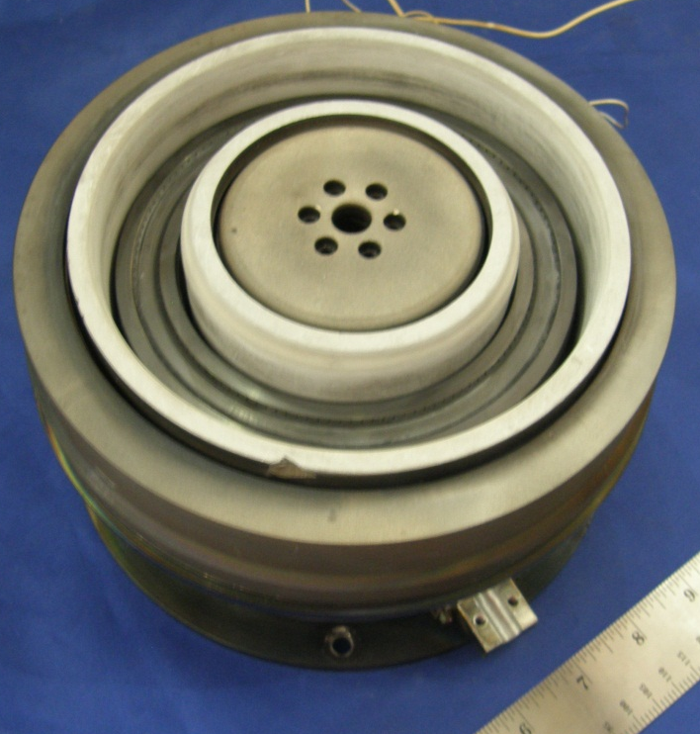
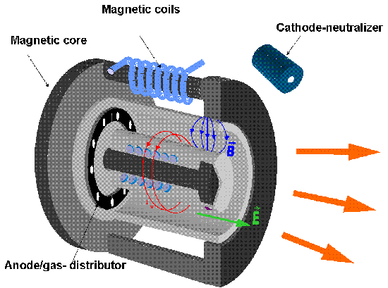
Background -- Hall Effect Thrusters
Inner wall
Anode
Outer wall
Graphite Cathode
Plasma Flow
Channel
Magnets

Slide 3
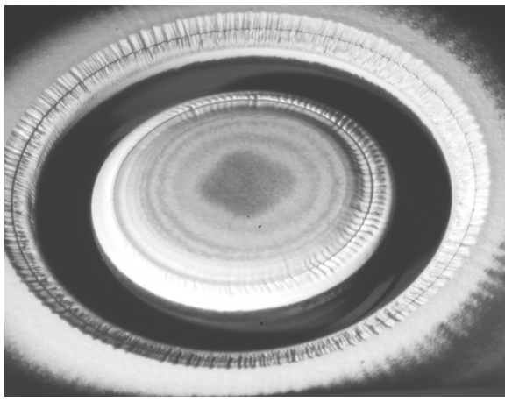
Background -- Wall Erosion in HET
Wall Erosion
Sputtering of wall material into plasma?
Thermal degradation from thermal cycling?
Implantation of ion species into wall material?
Motivation:
Identify mechanisms of erosion
Surface topology alterations and influence on plasma stability
(need to develop a quantifiable description of how the surface evolves under plasma operation)
HET Wall Chamber material types
High Purity BN
Combat©M26
60wt% BN - 40wt%SiO₂

Slide 4
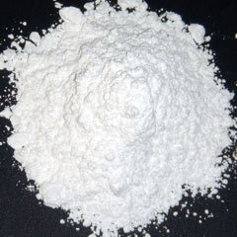
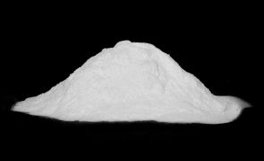
Background -- Processing of M26
Monoliths produced by Saint Gobain Advanced Ceramics -- mixing and hot pressing
Sectioned and machined to consumer specification

Slide 5
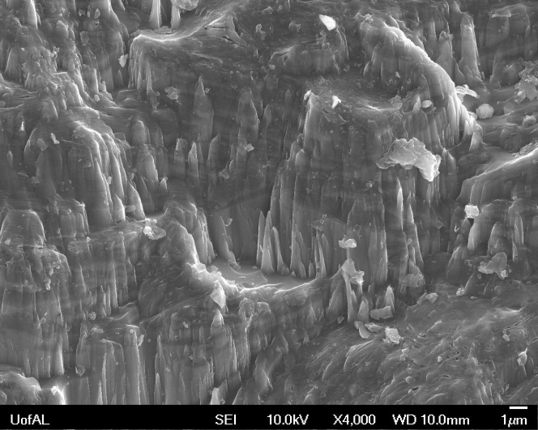
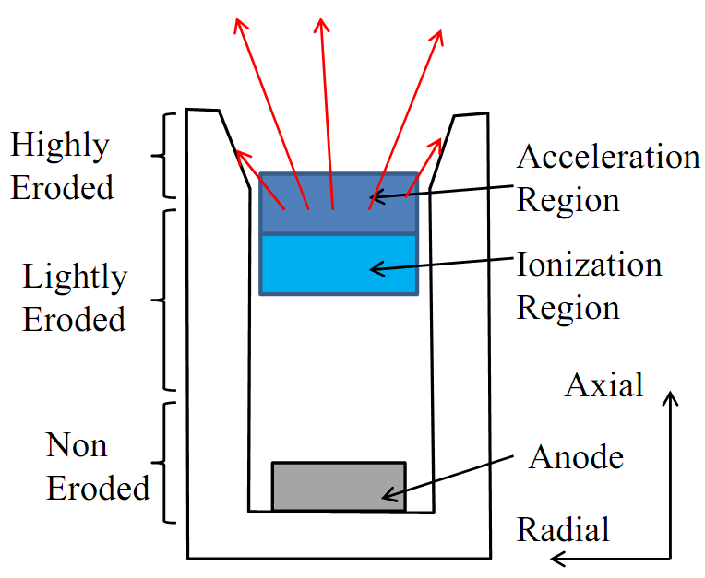
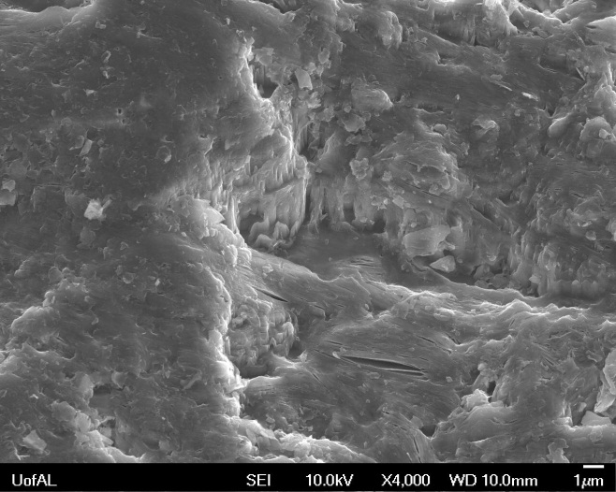
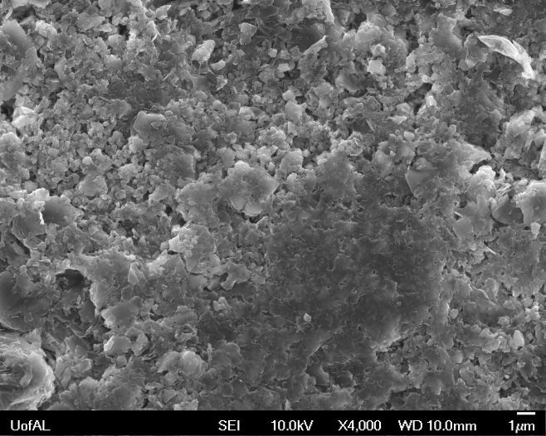
Analysis -- Microstructural Erosion
High Erosion
Schematic of HET Discharge
5 μm
Mild Erosion
5 μm
Low Erosion
UM/AFRL P5 HET*
1.5 – 5 kW Operation
2,000 hrs
Xenon Plasma
*de Grys, Kristi. et all. “Demonstration of 10,400 Hours of Operation on a 4.5 kW Qualification Model Hall Thruster,”
5 μm

Slide 6
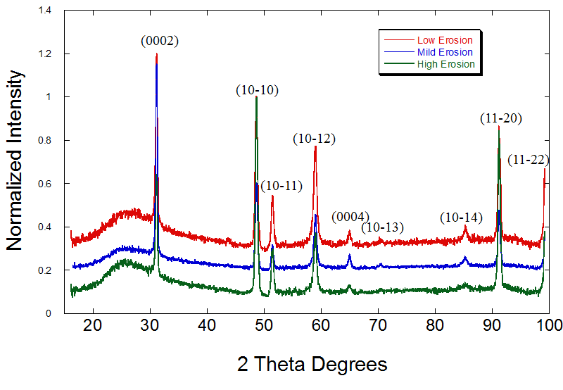
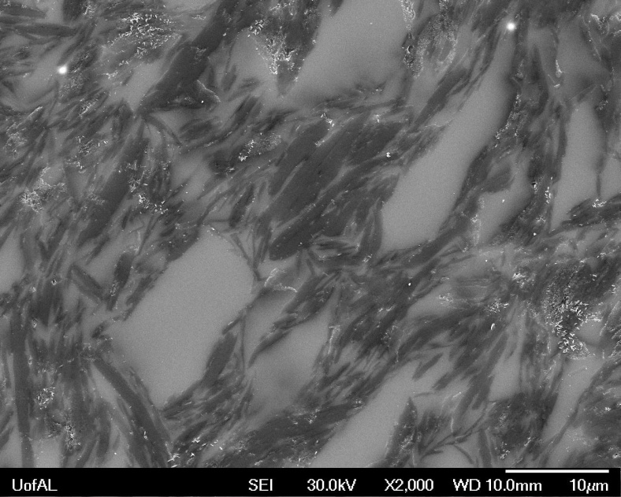
Analysis -- Phase Identification
hcp BN
Amorphous silica
10 μm
No change in phase stability as function of eroded region
Silica (bright contrast) serves as a binding matrix with BN fibers (dark contrast)

Slide 7
Analysis -- 3D Serial Section of a BN Grain

Slide 8
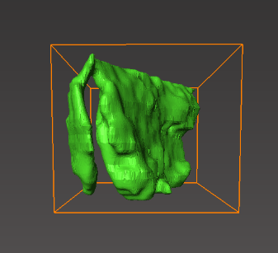
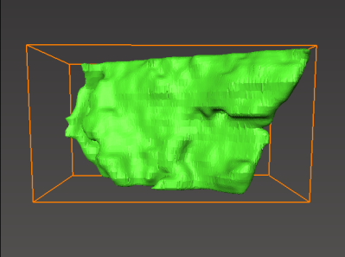
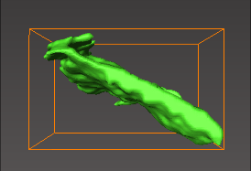
Analysis -- 3D Serial Section of a BN Grain
Serial sectioning
ROI
5 μm
5 μm
5 μm
Serial sectioning was unable to be performed in the traditional manner using a Focused Ion Beam (FIB) system due to the non-conductive nature of the material. Instead, a traditional mounted sample was bisected allowing for two visible faces. The top face was repeatedly polished using 0.05um silica solution to act as the serial sectioning force. The side face had a reference mark milled into it using the FIB and the distance between the marker and the top faced used as the thickness for each serial section. Reconstructed was performed using the program Aviso Fire, and the resulting reconstruction suggests a BN platelet morphology, as would be expected from a graphite-like material.

Slide 9
Analysis -- Highly-Eroded Region
D
Smooth planar silica surface –
BN micro-fiber exfoliation
Weak interphase bonding leading to grain exfoliation?
Micro-cracking prevalent in the BN phase
Exclusively along long axis of phase
Thermal expansion stresses?
Ion implantation stress (hcp BN versus more ‘open volume’ amorphous silica phase)?
Sputtering effects?
5 μm
10 keV secondary electron SEM micrograph
Surface protrusions –
Possible sputter erosion mechanism→ modeling underdevelopment
Secondary electron emission sites?

Slide 10
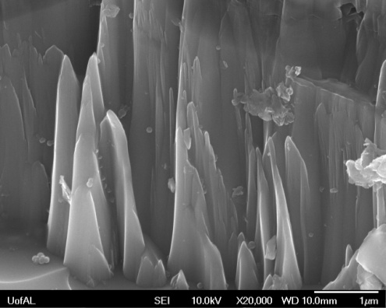
Analysis -- Topological Changes
Surface protrusions:
Comprise a laminate structure of BN and amorphous silica
1μm
Needle shape protrusions can be secondary electron emission source which influences plasma equilibrium with the wall material – future work

Slide 11
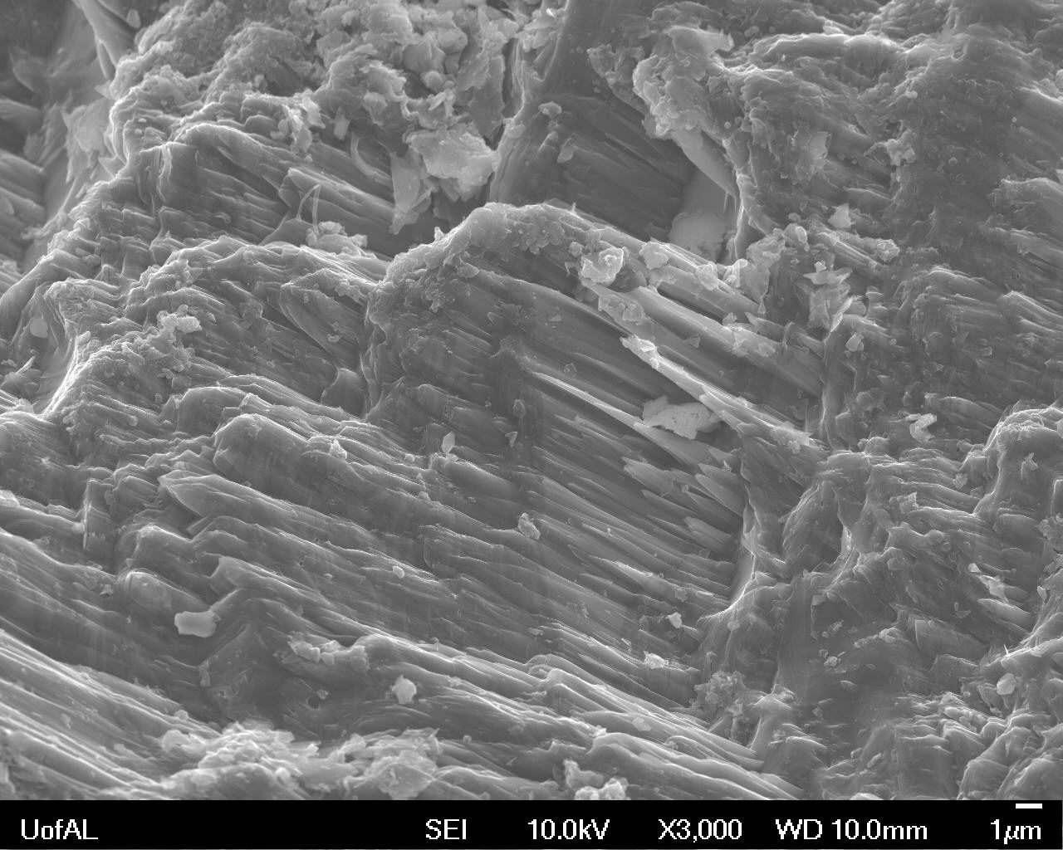
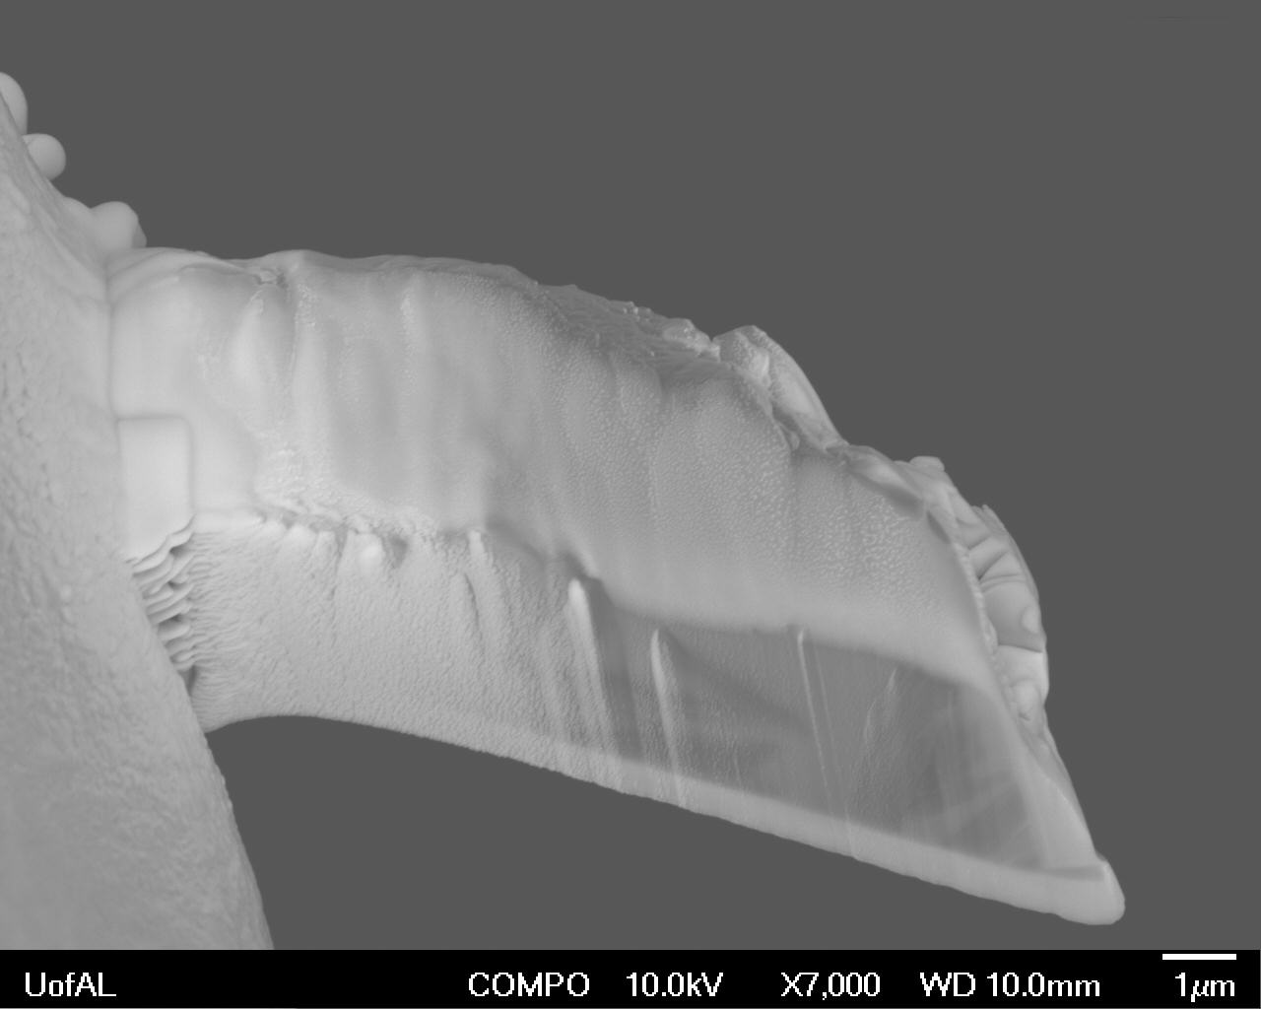
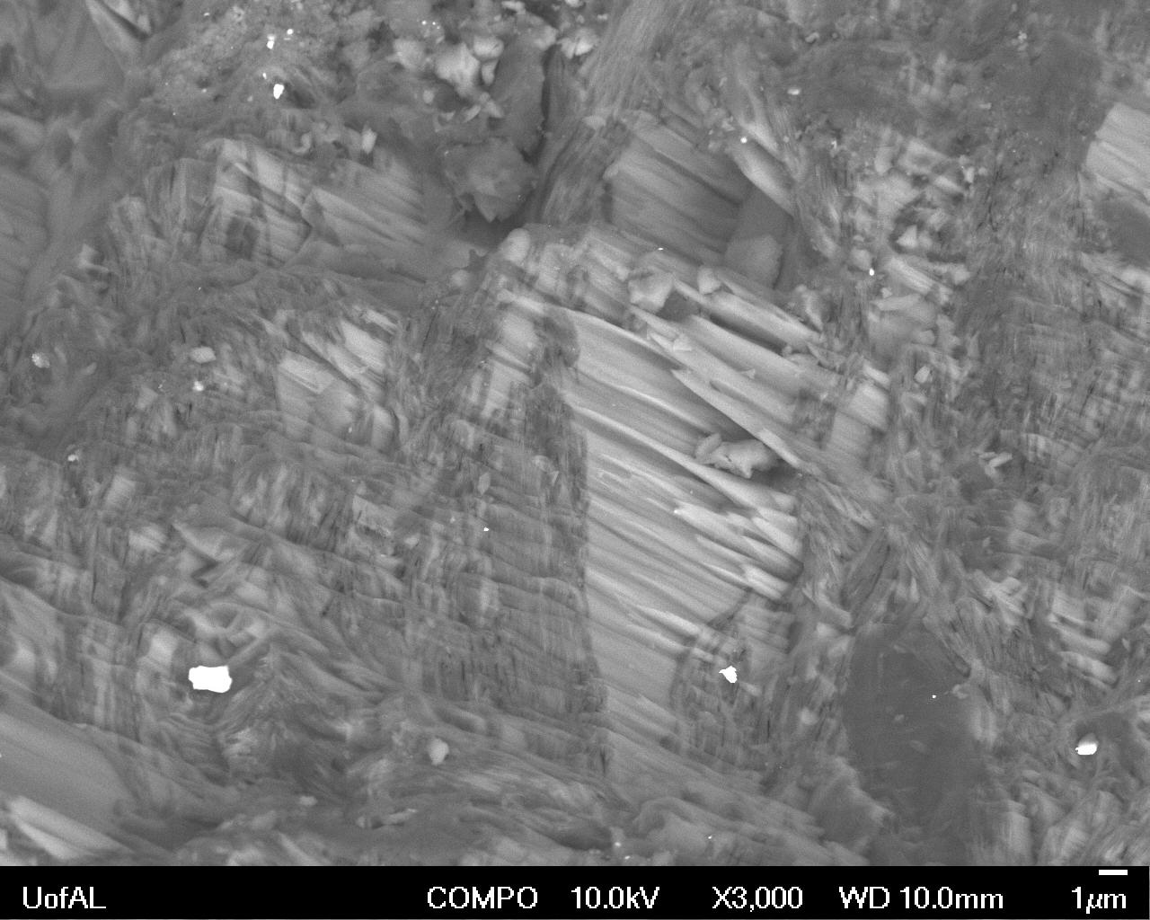
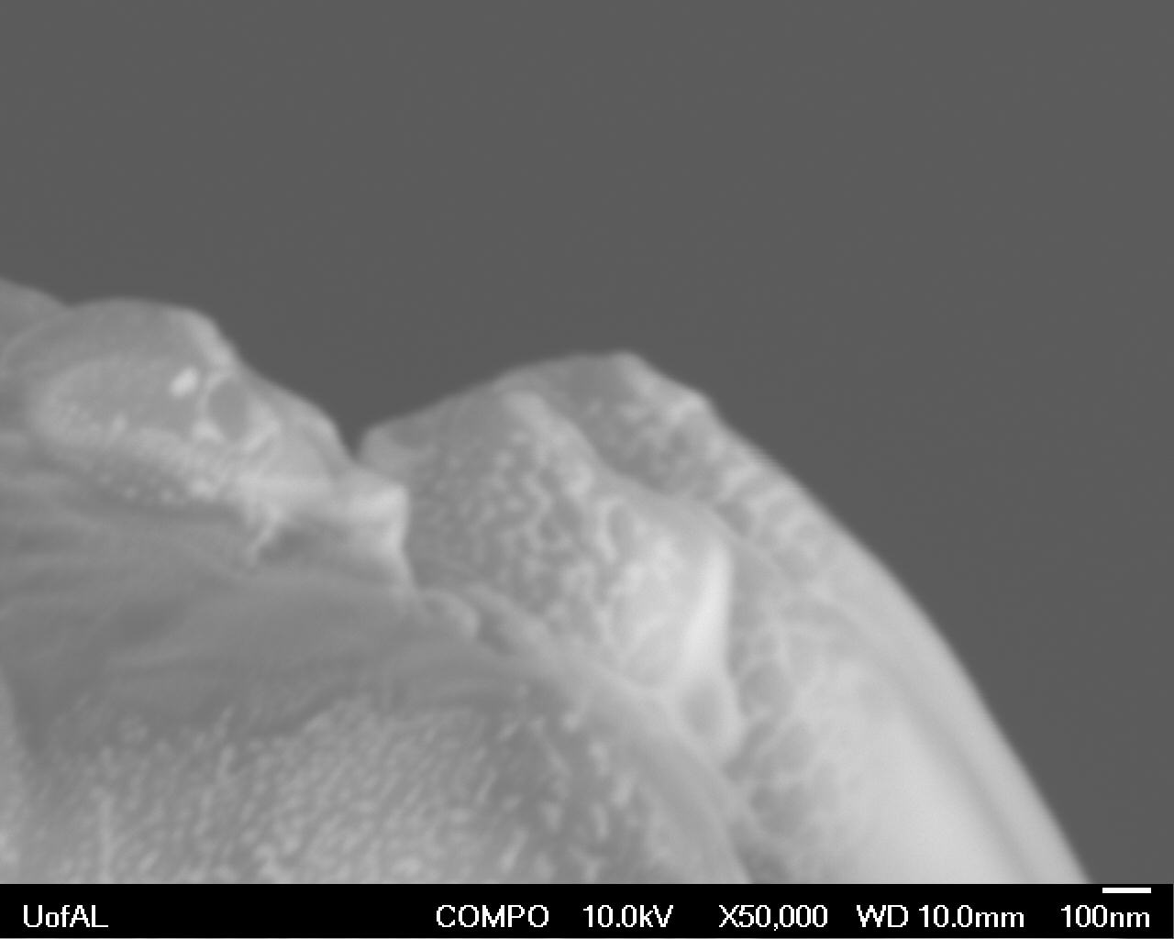
Analysis -- Compositional Analysis of Surface Protrusions
Nitrogen
Secondary Electron SEM micrograph
1μm
1μm
Boron
Silicon
Oxygen
Back Scattered Electron SEM micrograph
1μm
100nm

Slide 12
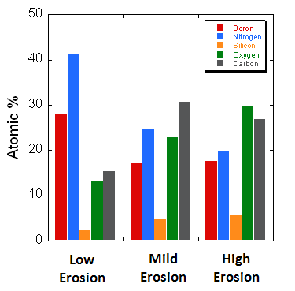
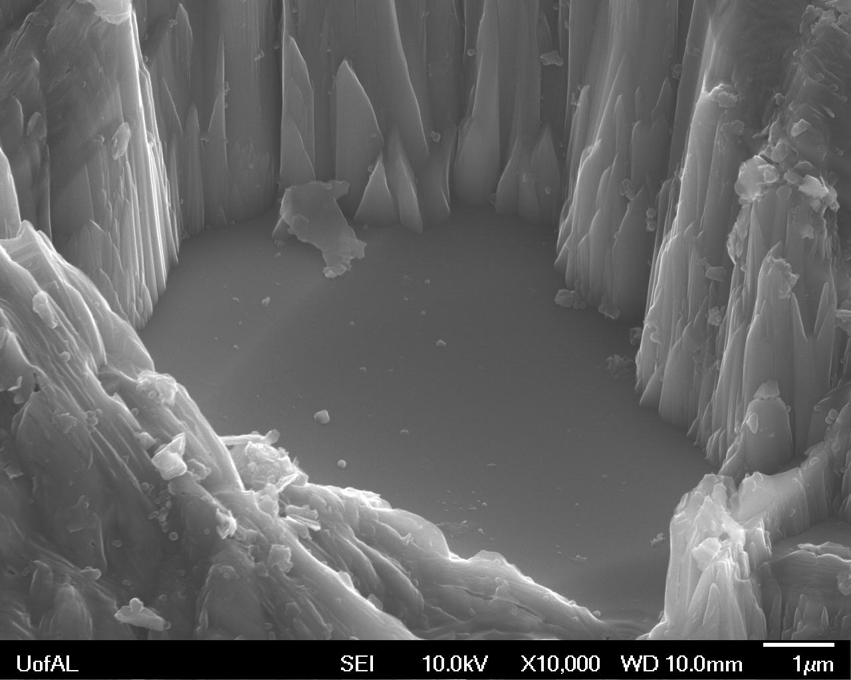
Analysis -- Chemical Analysis of Eroded Regions
X-ray Photospectroscopy (XPS):
Preferential retention of silica in highly eroded region. In agreement with Garnier et al. "Low-Energy Xenon Ion Sputtering of Ceramics Investigated for Stationary Plasma Thrusters." J. of Vac. Sci. Tech. A 17. 6. 3246-3254 (1999).
Binding energy of BN > silica. Should expect slower sputter rate with BN…
BN exfoliation important mechanism for BN loss from the channel wall surface
1 μm

Slide 13
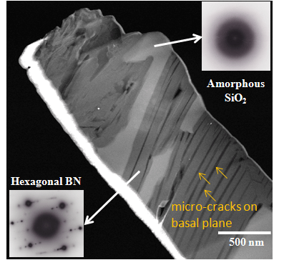
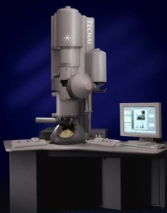
Analysis -- Micro-Cracking in Boron Nitride Phase
Phase identification confirmed amorphous silica and hcp BN
Prevalent and parallel micro-cracking in BN. Identified to be along the basal plane
Weak out-of-plane bonding (similar to graphite)
B, N
TEM
SEM micrograph – cracking most prevalent in BN, but some seen in silica
FIB extraction

Slide 14
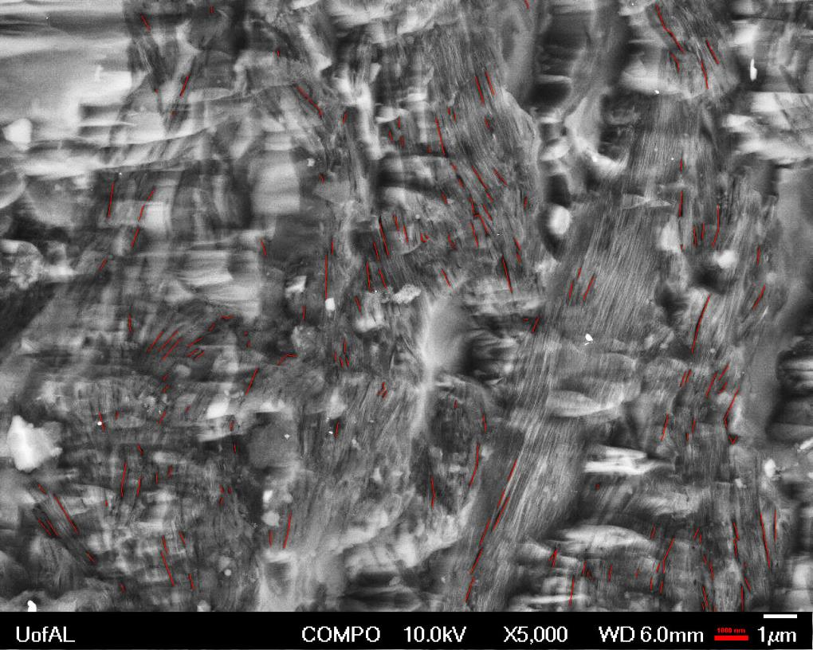
Analysis -- Investigation of Micro-cracking in Erosion Regions
Red lines indicate measured cracks
Average Crack Length: 535nm
Total Number of Cracks: 168/1400 mm²
Average Crack Length: 589nm
Total Number of Cracks: 663/1400 mm²
1μm
Conclusion: Increasing number of cracks with increasing erosion region suggests primary cracking mechanism to be nucleation of new cracks.
Average Crack Length: 502nm
Total Number of Cracks: 927/1400 mm²

Slide 15
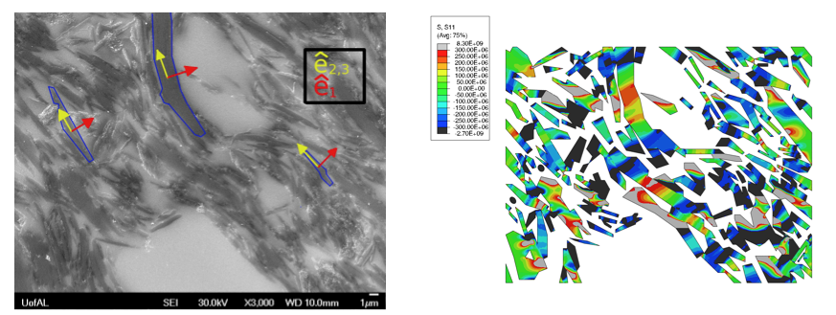
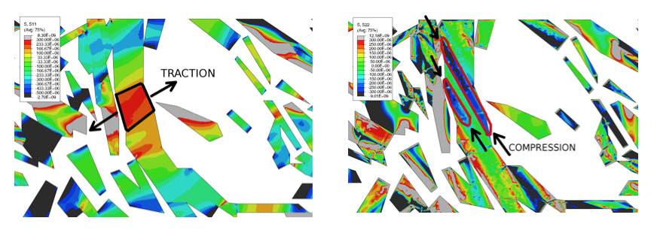
Analysis -- Thermally Induced Micro-Cracking – Finite Element Model
Simulation conditions:
Anisotropic thermal expansion coefficient and elastic properties assigned to each boron nitride grain
Silica phase assumed to be isotropic.
Nominal temperature of 500K
Preliminary results:
Grains are found to experience tensile stresses on the order of 100s of MPa in the direction perpendicular to the basal plane while experiencing similar compressive stresses on the orthogonal direction
This stress state could easily lead to the kind of micro-cracks observed.
Micrograph utilized for geometric representation
Basal-component of stress tensor for sample under thermal loading
Detail of tensile basal-component of stress tensor
Detail of compressive in-plane component of stress tensor

Slide 16
Conclusions
Identified three distinct features of plasma erosion microstructure
Micro-cracking
Surface protrusions
Boron Nitride exfoliation
Preferential Retention of SiO₂ over Boron Nitride
Suspected result of exfoliation
Surface protrusions as sites for Secondary Electron Emission
Future work quantifying effect of topology on electron emission
5 μm
Crack nucleation in Boron Nitride source of micro-cracking
Modelling suggests thermal expansion stress
Future work with thermal cycling

