Slide 1
3D Model for Atomic Sputtering of Heterogeneous Ceramic Compounds
Aaron M. Schinder, Prof. Mitchell Walker, Prof. Julian Rimoli
High-Power Electric Propulsion Lab
Georgia Institute of Technology
10 July 2013
49th AIAA/ASME/SAE/ASEE Joint Propulsion Conference & Exhibit

Slide 2
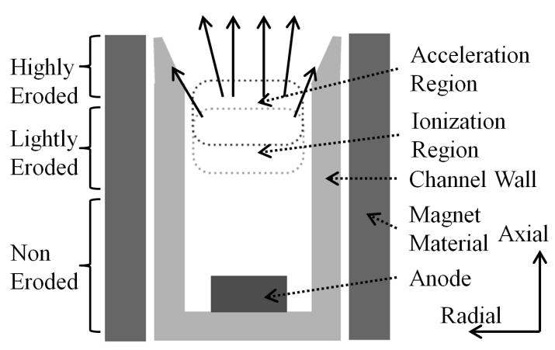
Motivation
Hall effect thrusters (HETs) are attractive for spacecraft propulsion and station-keeping
Operating life of HETs is limited by erosion of the discharge channel wall
Accelerated plasma erodes the channel wall where it impacts the surface
The discharge channel erodes, exposing magnetic circuit
Sputtering of magnetic circuit can lead to ferrous deposition, destroying electrical isolation and leading to unexpected failure
Cost of life tests is substantial
Life models reduce risk of life tests
Ability to predict life with conditions not addressed during life test
Ion Trajectories
Diagram of HET channel wall erosion process

Slide 3
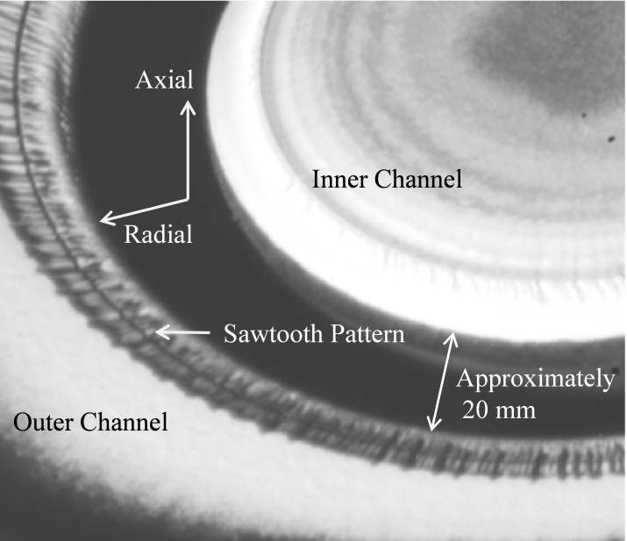
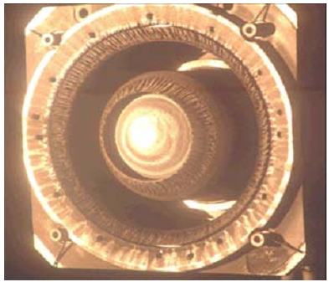
Motivation
Complex 3D surface structures develop in long-duration life testing of HETs
Left: BPT-4000 thruster, 10,400 hour life test, showing azimuthal saw-tooth erosion not captured in present modeling
Right: Eroded SPT-100 thruster
de Grys. Mathers. Welander., “Demonstration of 10,400 Hours of Operation on a 4.5 kW Qualification Model Hall Thruster,” AIAA Joint Propulsion Conference, 2010-6698
M. Dudeck, F. Doviel, et. al “Plasma Propulsion for Geostationary Satellites and Interplanetary Spacecraft”. 15th International Conference on Plasma Physics and Applications, 1–4 July 2010, Iasi, Romania

Slide 4
Motivation
Present erosion models model the material as a homogenous isotropic solid: No material driven process for formation of surface structure
Sparse experimental sputtering yield data for energies less than ~200 eV: Hall thruster ions have energies in the range of 100-300 eV
Present erosion models use an axisymmetric plasma model, such as HPHall, and do not produce information about 3D erosion features, or the 3D nature of microscopic surface roughness
In order to model the interaction of sputtering with the material microstructure, a 3D model of sputtering of a heterogeneous material is produced

Slide 5
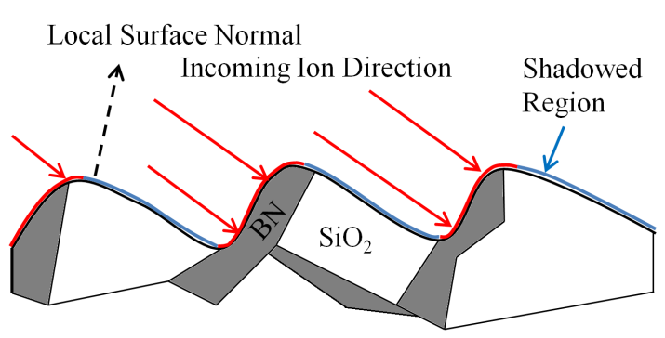
3D Heterogeneous Model: Introduction
To model the interaction of sputtering with the material microstructure, a 3D model of sputtering of a heterogeneous material is produced
Ray-tracing approach to heterogeneous atomic sputtering model

Slide 6
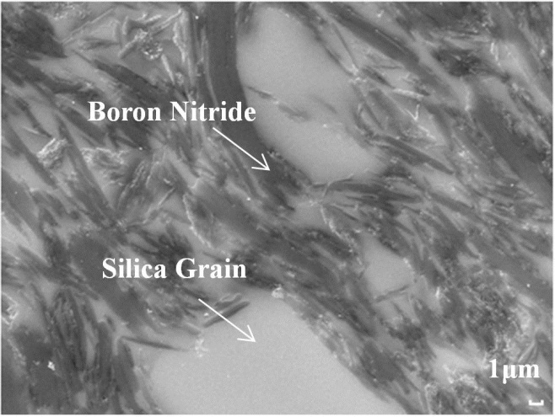
Empirical Background for Model
Ion Trajectories
AFRL/UM P5 Channel Wall
Material: M26 BN-SiO₂ composite (60% BN/40% SiO₂ by mass)
Most HETs use M26, machinability
SEM Imaging (surface and cross section)
XPS Imaging (surface composition)
LEXT Profilometry (surface.
Regions of Interest:
Non Eroded
Lightly Eroded
Highly Eroded (beyond acceleration zone)
Diagram of HET channel wall erosion process
SEM cross sectional image of M26 BN-SiO₂ microstructure

Slide 7
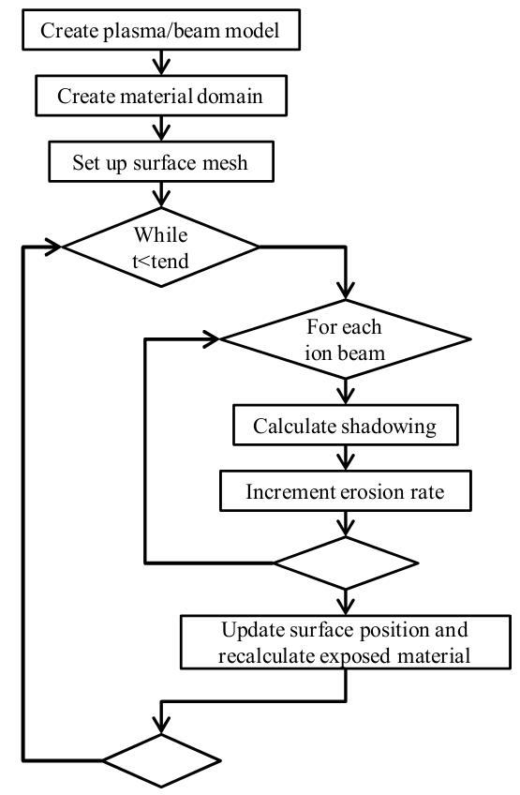
3D Heterogeneous Model: Overview
2d surface mesh is propagated into 3d model domain
1st order plasma model and single ion beams are used to model plasma conditions
Plasma model: displaced Gaussian velocity distribution fit to Ion Energy Distribution data
Ray-tracing is used to calculate shadowing of material from each ion beam
Erosion model flowchart

Slide 8
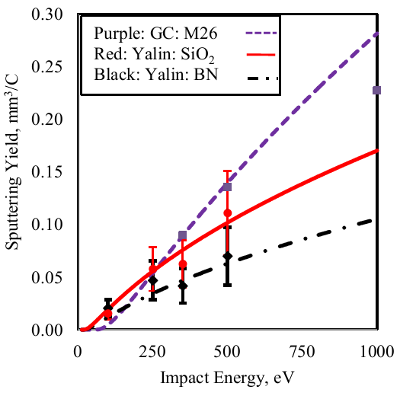
3D Heterogeneous Model: Component Models
BN and HBC phases were modeled with curve fits from Yalin et. al’s QCM sputtering yield experiments on HBC and quartz
Component model curve-fitting coefficients
Component model curve fits and data, 45°
 | Gamero-Castano | Yalin | Yalin
Material | M26 (60% BN, 40% SiO₂) | HBC (99% BN) | Quartz (Silica)
E_{th} (eV) | 58.6 | 18.3 | 18.3
B₀ | 9.90E-03 | 1.18 | 9.14E-01
B₁ | 0 | 1.94E-02 | 5.34E-02
B₂ | 6.04E-06 | 1.22E-04 | -6.98E-04
B₃ | -4.75E-08 | -2.22E-06 | 3.33E-06
K | 1.00E+00 | 2.28E-03 | 3.50E-03
Yalin, A. P., Rubin, B., Domingue, S. R., Glueckert, Z., and Williams, J. D., "Differential Sputter Yields of Boron Nitride, Quartz, and Kapton Due to Low Energy Xe+ Bombardment," AIAA Paper 2007-5314, July 2007

Slide 9
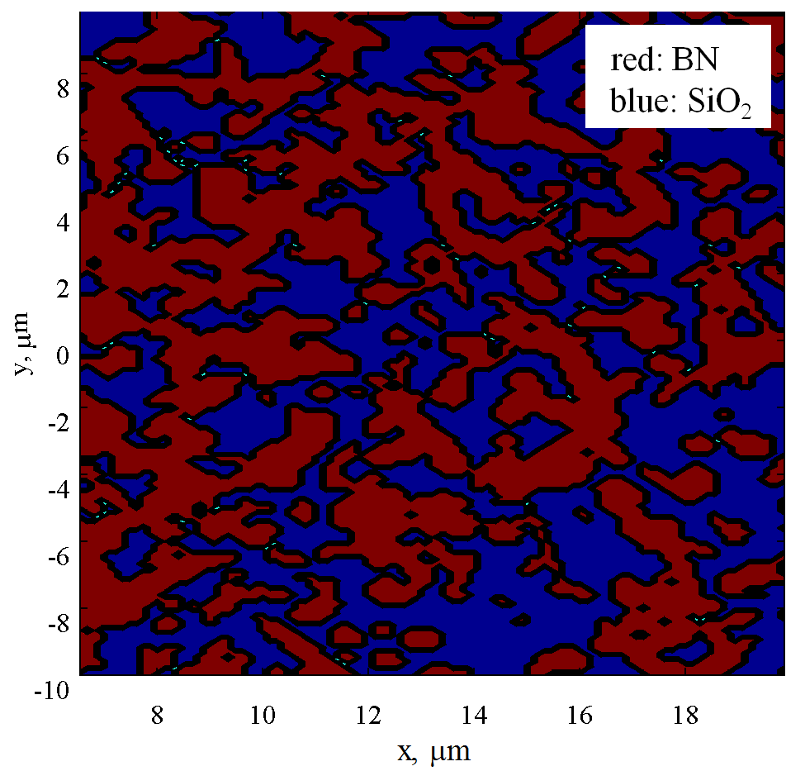
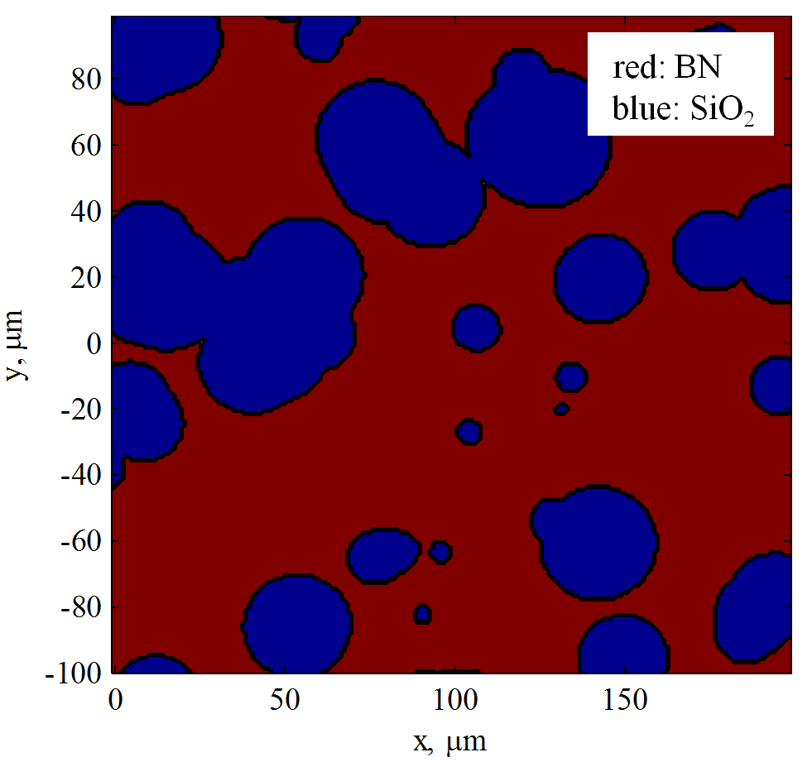
3D Heterogeneous Model: Material Domain Models
Large and small scale domain models focus on different features of material domain
Small scale domain model
Focus: Individual BN flakes
Large scale domain model
Focus: Silica voids and BN rich regions
Large scale structure, roughness
SEM cross sectional image of M26 BN-SiO₂ microstructure

Slide 10
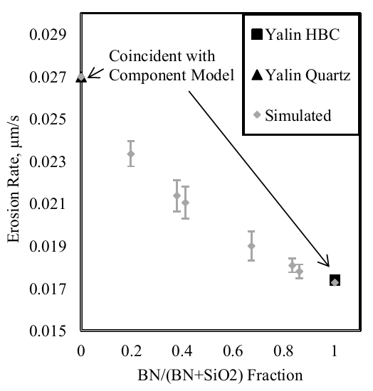
Results: Deviation from Law of Mixtures
Model was validated for convergence of average erosion rate
Model was validated by varying mixture fraction
Result: Surface structure produces deviation from law of mixtures
Effect of shadowing, surface features
Avg. Erosion rate biased towards lower yield component
Average and one standard deviation of erosion rate as a function of mixture fraction

Slide 11
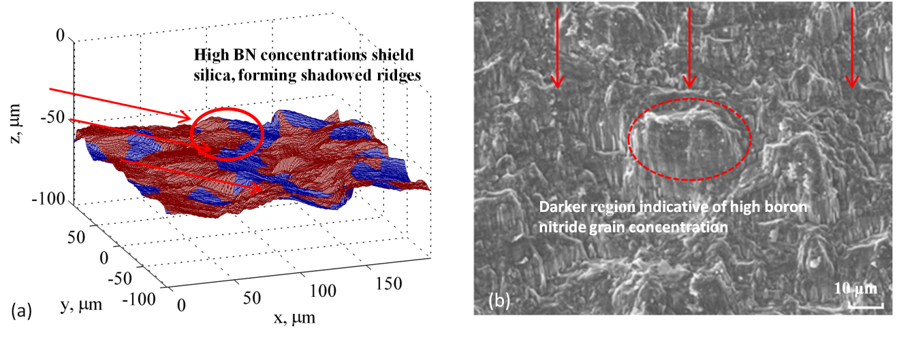
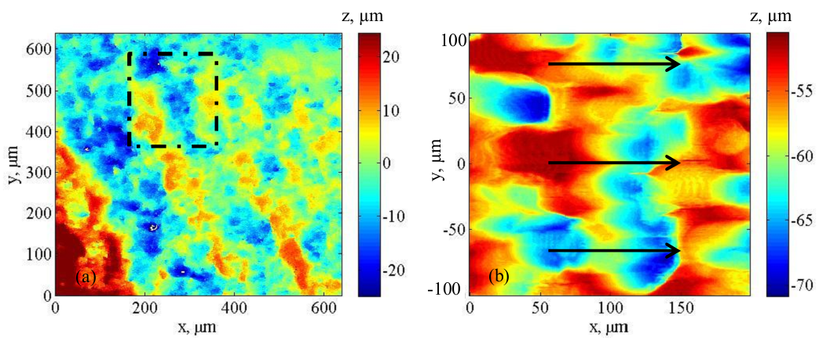
Results: Qualitative Surface Features
Conditions for figures: 750 s, 30º ion incidence, 3*10¹⁷ m⁻³ Xe
Reproduction of cliff and valley structures
BN rich regions shadow higher yield silica material behind them
Surface roughness results. Features highly sensitive to ion incidence angle
Moderate incidence angles of ~30° correspond to observed features
a) Simulated erosion profile, b) SEM image of highly eroded section of channel wall
a) Surface height profile of P5 channel wall b) Simulated profile, 30º incidence, 750 s, 3E17 m⁻³

Slide 12
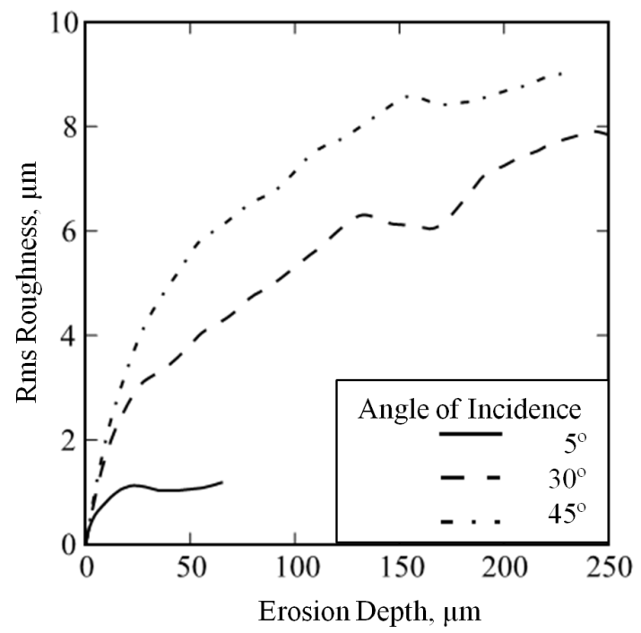
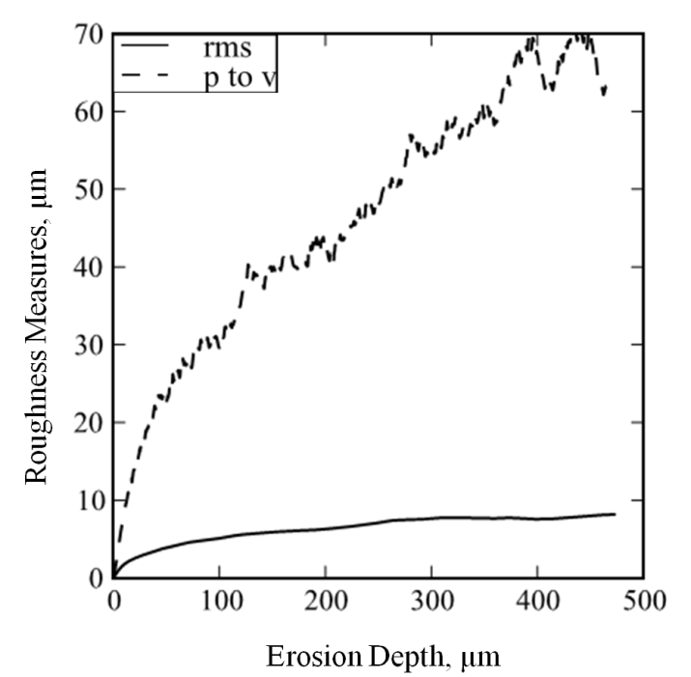
Results: Quantitative Roughness for Moderate Incidence Angles
Ion incidence angle was varied to produce profiles with different features and surface roughness characteristics
The 30° ion incidence case has the closest roughness to experiment: 8 µm compared to 6 ± 2.5 µm
For my longest time-scale runs, rms roughness remains bounded. Peak-to-valley distance continues to increase
Top: Rms roughness as a function of erosion depth, angle series
Bottom: Rms, peak-to-valley roughness, long-time-scale simulation

Slide 13
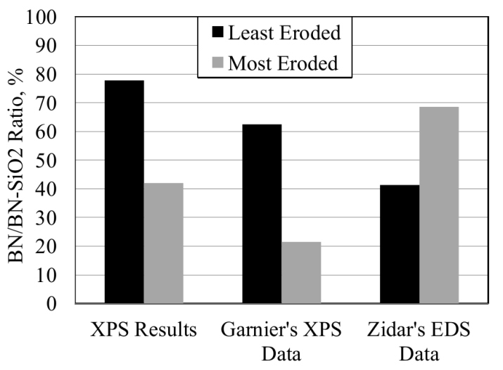
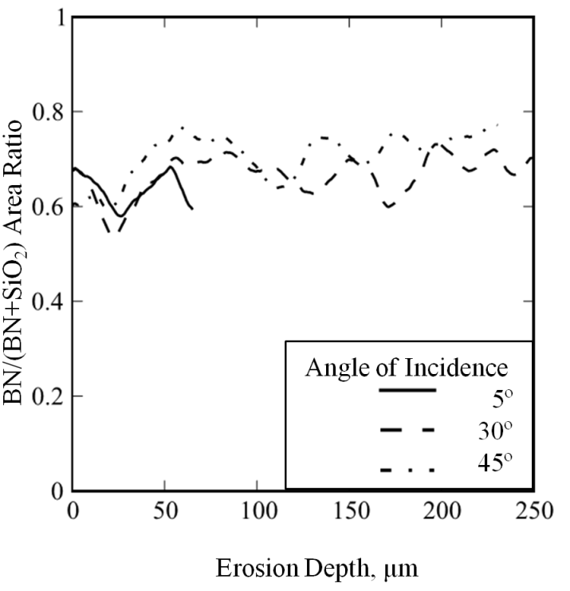
Results: Composition of Surface
Composition of the P5 channel wall was measured via X-ray photoelectron spectroscopy (XPS)
Experimentally, a reduction in BN in the highly eroded region of the P5 thruster was found. BN is the lowest-yield phase, and was expected to persist relative to silica
This result is corroborated by Garnier’s XPS of M26 pre and post exposure to an ion beam
The simulation shows no significant variation in simulated surface composition. (A slight increase of 10% with no coherent trend afterwards)
Top: Empirical measurements of composition pre and post plasma exposure
Bottom: Simulated variation in surface composition with erosion depth

Slide 14
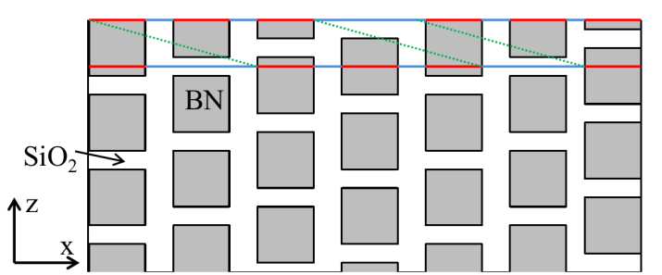
Results: Composition of Surface
A purely atomic sputtering approach to erosion cannot capture the observed variation in surface composition
Simplified analytical model:
As plane moves into regular domain, no variation in surface composition results: Similar but translated images of initial surface:

Slide 15
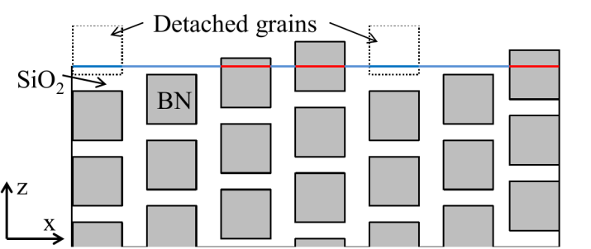
Results: Composition of Surface
Grain ejection model:
If BN grains protrude from a silica matrix to the point where a critically small support is obtained, they are detached and ejected from the material
This model can explain an increase in silica in material that has been eroded.
Subject of future work

Slide 16
Conclusions
Shadowing introduces deviation from a simple law of mixtures wrt. erosion
Qualitative surface features reproduced for moderate, but not shallow ion incidence angles. Cliff and valley structure reproduced
Surface roughness reproduced for moderate ion incidence angles: 8 µm simulated, 6±2.5 µm observed
Observed composition not reproduced in atomic sputtering model. Grain ejection model is presented as plausible mechanism for composition changes, to be investigated in future work

Slide 17
Questions?

